Slide 1
Stereo Vision & Depth Estimation
Vyom Devgan

Slide 2
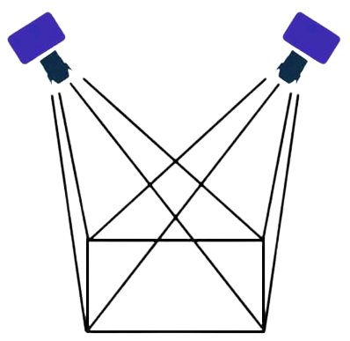
Overview
Stereo vision helps us see things in 3D using two eyes or cameras.
Depth estimation helps us understand how far things are from us.
1
2

Slide 3

Experiment Time

Slide 4
Explanation
Just like you have two eyes to see things, stereo vision uses two cameras to see things in 3D.
Depth estimation helps figure out how close or far away things are, like when you see a bird flying high or a bug crawling close to you.

Slide 5
Stereo Vision & Depth Estimation in Computer Vision
Computers use two "eyes" (cameras) to understand 3D things like we do.
They use special tricks to figure out how far things are from the cameras.
They look for differences in the pictures to guess how close or far things are

Slide 6
Core Concepts
Stereo vision involves capturing images from multiple viewpoints and analyzing disparities to understand depth.
Depth estimation relies on triangulation principles to calculate distances based on known parameters and identified disparities.

Slide 7
Techniques & Algorithms
Techniques like block matching and algorithms like Semi-Global Matching (SGM) are used for stereo matching and disparity calculation.
Deep learning approaches, including convolutional neural networks (CNNs), show promise in stereo vision tasks.

Slide 8
Applications
Stereo vision and depth estimation are crucial for 3D reconstruction, robotic perception, augmented reality (AR), and medical imaging.
They enable tasks such as understanding environments, navigating robots, enhancing AR experiences, and analyzing medical scans with depth information.

Slide 9
Thank you
Questions?

Slide 10
References
Tippetts, B., Lee, D.J., Lillywhite, K. et al. Review of stereo vision algorithms and their suitability for resource-limited systems. J Real-Time Image Proc 11, 5–25 (2016). https://doi.org/10.1007/s11554-012-0313-2
Grimson W. E. L. 1981A computer implementation of a theory of human stereo vision Phil. Trans. R. Soc. Lond. B292217–253 http://doi.org/10.1098/rstb.1981.0031

